Slide 1
DC and PP lecture 1
Historic motivation of networking
The historic motivation:
not to transmit data from one source to a destination
was as a desire to share expensive computer resources.
early computers were large centralized and were very expensive to own.
Only a few big companies could afford them e.g. the U S army, IBM and Government departments such as Salary Service Bureau and others.
Computer programs took long to run and computers could not be found everywhere as is the case now.

Slide 2
History of networking
Advanced research projects agency (ARPA) initiated the project to connect researchers with computers. A new technology such as packet switching was adopted for transmitting data over a networking arrangement. Such early packet technology includes Asynchronous Transfer mode (ATM), Frame relay and Integrated Services Digital Network (ISDN). This new technology resulted in systems accessing remote expensive computing resources. This system of internetworking was called ARPANet and it started the late 1960s. Arpanet was not using the Transmission Control Protocol (TCP)/Internet Protocol but was using Network Control Program (NCP).

Slide 3
Networking value addition
Networking brought with itself networking value addition such as:
Resource sharing
Data sharing
Easy coordinated communication

Slide 4
Terminology
Frequency
number of waves that pass through a fixed place in a given amount of time for example if the time it takes for a wave to pass is ½ a second, then the frequency is 2 per second.
For the alternating/ varying current, frequency is the number of complete cycles per second in alternating current direction.

Slide 5
Frequency is measured in hertz (Hz) .If a current completes one cycle per second, then the frequency is 1 Hz.
If current completes 80 cycles per second, this equals 80 Hz.
Larger units of frequency include kilohertz (kHz) 1000’s cycles per second, Megahertz (MHz) millions of cycles per second , Gigahertz(GHz) billions of cycles per second

Slide 6
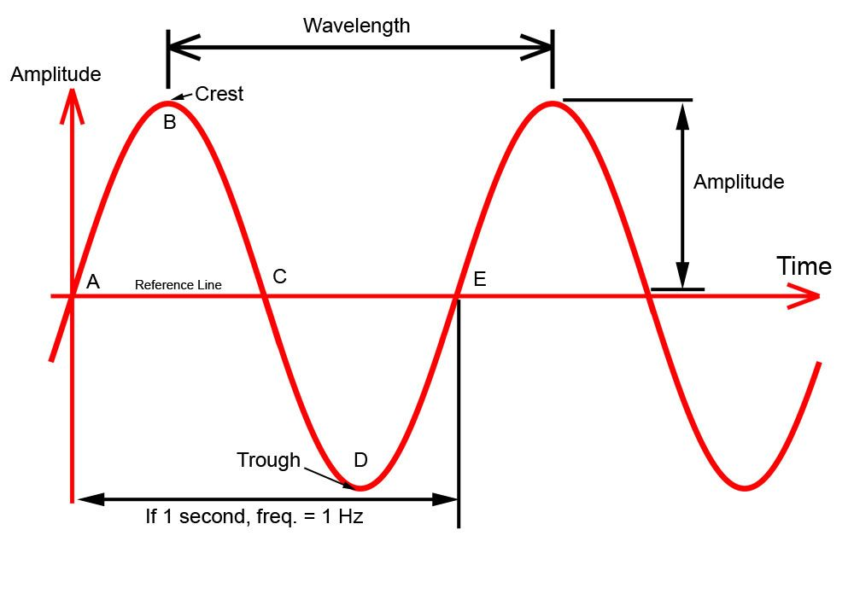
Wavelength

Slide 7
defined as the distance from a particular height on the wave to the next spot on the wave where it is at the same height and going in the same direction. (See diagram).
wavelength is designated by the symbol lambda (ƛ).
Frequency and wavelength are inversely proportional to each other (i.e. as one increases, the other decreases and vice-a-versa).

Slide 8
The relationship can also be established via speed, e g.
F= 1/T, v = f, ƛ = v/f : f = ƛ

Slide 9
Baud rate
is the number of signals or symbol changes that occur per second.
A symbol is one of several:
can be voltage
frequency or phase change.
Bit rate is the speed of data expressed in bits per second (bps).

Slide 10
The data rate (R) is a function of the duration of the bit or bit time. R = 1/T_{B} bits/s. The Rate is also called the channel capacity(C). If the bit time is 10 nanoseconds, the data rate:
R = 1/10 x10⁻⁹ = 100 million bits per second. This is usually expressed as 100M bps.

Slide 11
In the Non Return to Zero (NRZ) transmission code, the bit rate and the baud rate are equal.
For example in the NRZ, data switches between two levels, such as +3v for a binary 1 and +0,2v for a binary 0.

Slide 12
Bandwidth
Bandwidth is the range of frequencies between the upper and lower frequencies in a continuous set of frequencies.

Slide 13
Transmission Media
Data communication, also commonly called computer networking is the transfer of information between a source (transmitter) and a destination (receiver).
A data communication system has five major components, that is:
- Message
- Sender (transmitter)
- Receiver
- Transmission medium or communication channel
- Protocol (Encoder and Decoder)

Slide 14
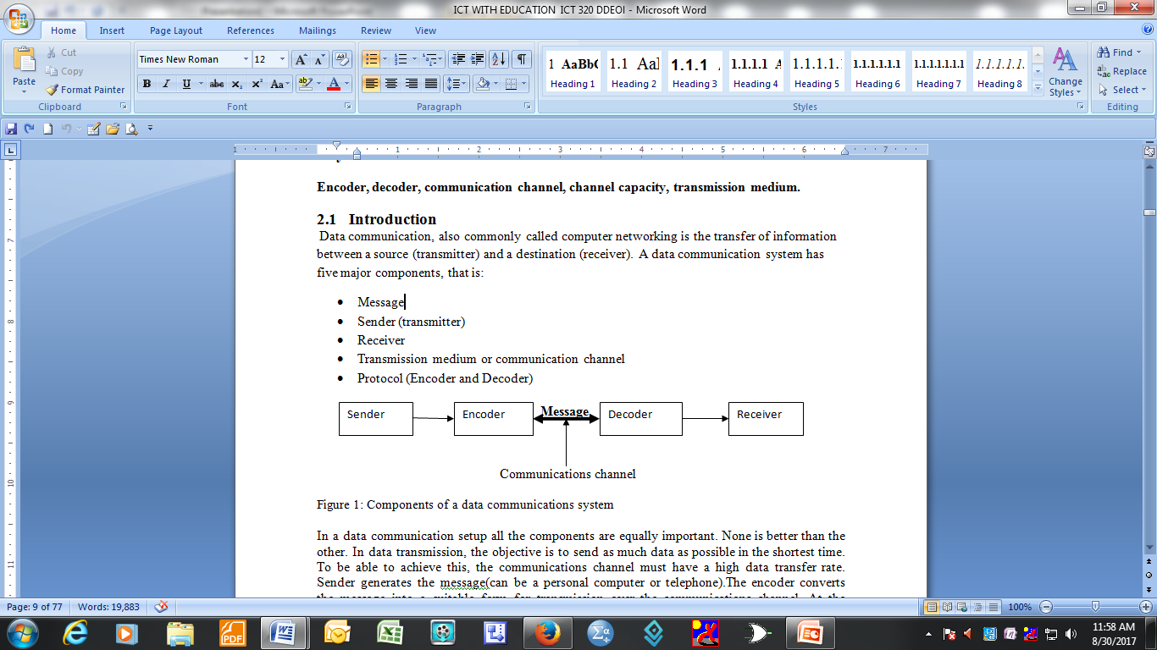
Data Communication System components

Slide 15
Components
all the components are equally important. None is better than the other.
the objective is to send as much data as possible in the shortest time.
To be able to achieve this, the communications channel must have a high data transfer rate.
Sender generates the message(can be a personal computer or telephone).

Slide 16
Components functions
The encoder converts the message into a suitable form for transmission over the communications channel. At the receiver the message is decoded back to the original form for human use.

Slide 17
Transmission Media
In data communication, the basic idea is to encode data (message) as energy and then transmit the energy.
At the destination (receiver) the energy is decoded back into data (message).
The energy can be: electrical (current, voltage, light, radio waves or sound waves).

Slide 18
Transmission media categories
There are two broad categories of transmission media:
- Guided
- Unguided

Slide 19
Guided Transmission media
In the guided transmission media,
the signal follows a specific path such as a wire.
The form of energy used here is electrical energy.
The guided transmission media category is further subdivided into open wire, twisted pair, coaxial, and optical.

Slide 20
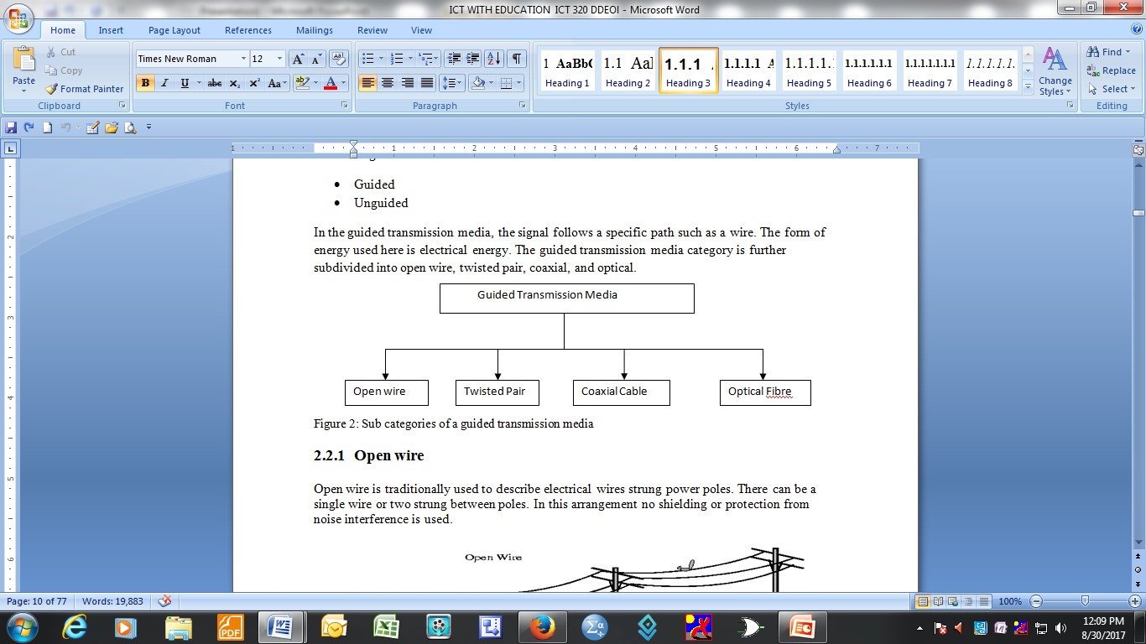
Categories of guided transmission media

Slide 21
Open wire
Open wire is traditionally used to describe electrical wires strung power poles.
There can be a single wire or two strung between poles.
In this arrangement no shielding or protection from noise interference is used.

Slide 22
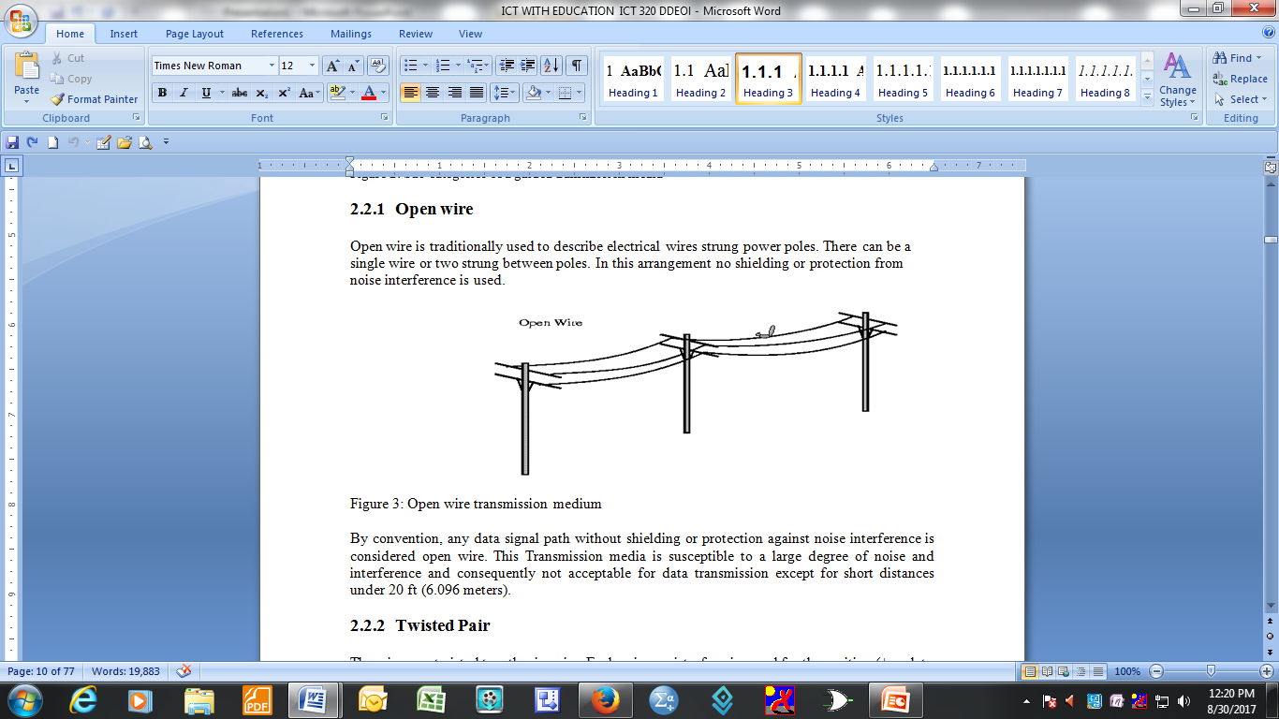

Slide 23
By convention, any data signal path without shielding or protection against noise interference is considered open wire.
This Transmission media is susceptible to a large degree of noise and interference and consequently not acceptable for data transmission except for short distances under 20 ft (6.096 meters).

Slide 24
Twisted Pair
The wires are twisted together in pairs.
Each pair consist of a wire used for the positive (+ve data signal) and a wire used for the negative (-ve data signal).
Any noise that appears on one wire of the pair would occur on the other wire.
The wires are of opposite polarities, and are 180 degrees out of phase.

Slide 25
When the noise appears on both wires, it cancels or nulls itself out at the receiving end.
The wires are often shielded to prevent electromagnetic interference.
The twisted pairs were used very much in old telephone networks and in data communication

Slide 26
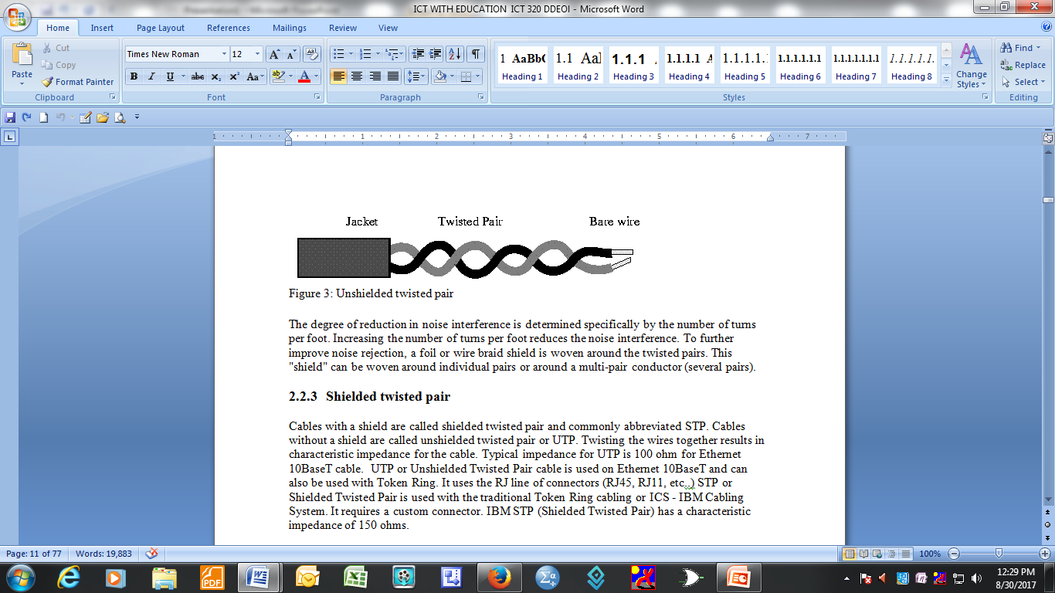
Unshielded twisted pair

Slide 27
The degree of reduction in noise interference is determined specifically by the number of turns per foot.
Increasing the number of turns per foot reduces the noise interference.
To further improve noise rejection, a foil or wire braid shield is woven around the twisted pairs.

Slide 28
This "shield" can be woven around individual pairs or around a multi-pair conductor (several pairs).

Slide 29
Shielded twisted pair
Cables with a shield are called shielded twisted pair and commonly abbreviated STP.
Cables without a shield are called unshielded twisted pair or UTP.
Twisting the wires together results in characteristic impedance for the cable.
Typical impedance for UTP is 100 ohm for Ethernet 10BaseT cable.

Slide 30
UTP or Unshielded Twisted Pair cable is used on Ethernet 10BaseT and can also be used with Token Ring.
It uses the RJ line of connectors (RJ45, RJ11, etc..)

Slide 31
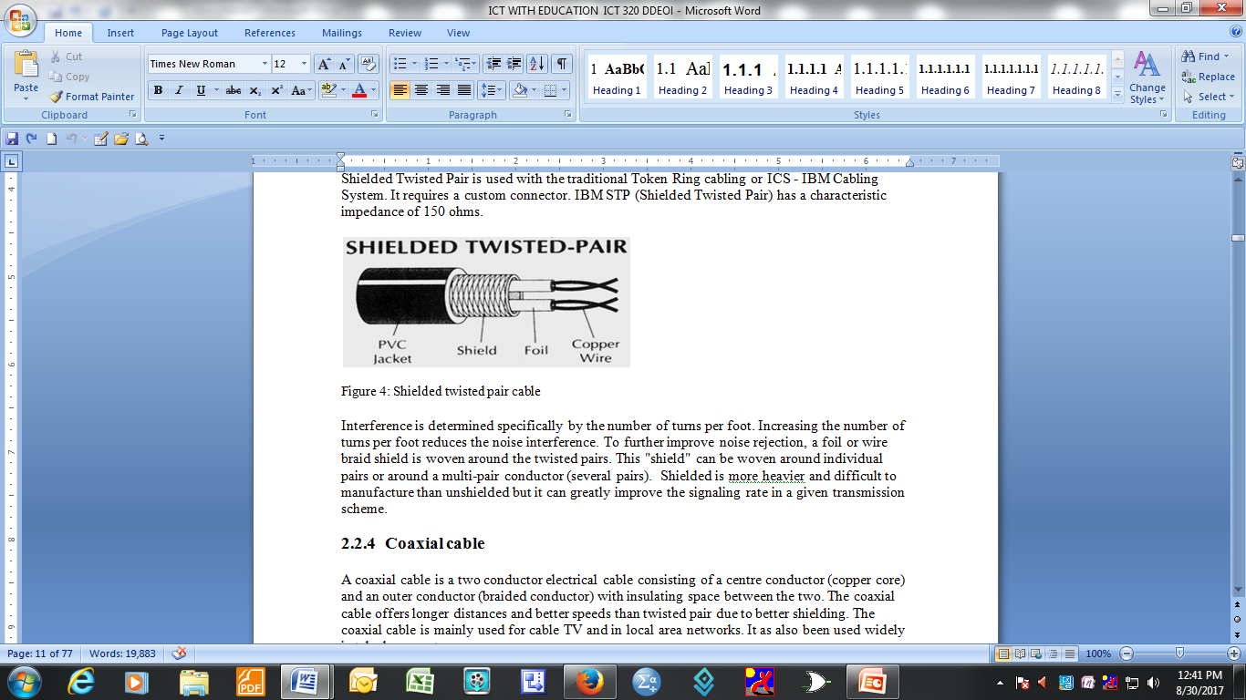

Slide 32
Interference is determined specifically by the number of turns per foot.
Increasing the number of turns per foot reduces the noise interference.
To further improve noise rejection, a foil or wire braid shield is woven around the twisted pairs.
This "shield" can be woven around individual pairs or around a multi-pair conductor (several pairs).

Slide 33
Shielded is more heavier and difficult to manufacture than unshielded
but it can greatly improve the signaling rate in a given transmission scheme.

Slide 34
Coaxial cable
A coaxial cable is a two conductor electrical cable consisting of a centre conductor (copper core) and an outer conductor (braided conductor) with insulating space between the two.
The coaxial cable offers longer distances and better speeds than twisted pair due to better shielding.
The coaxial cable is mainly used for cable TV and in local area networks.

Slide 35
It as also been used widely in telephone systems.

Slide 36
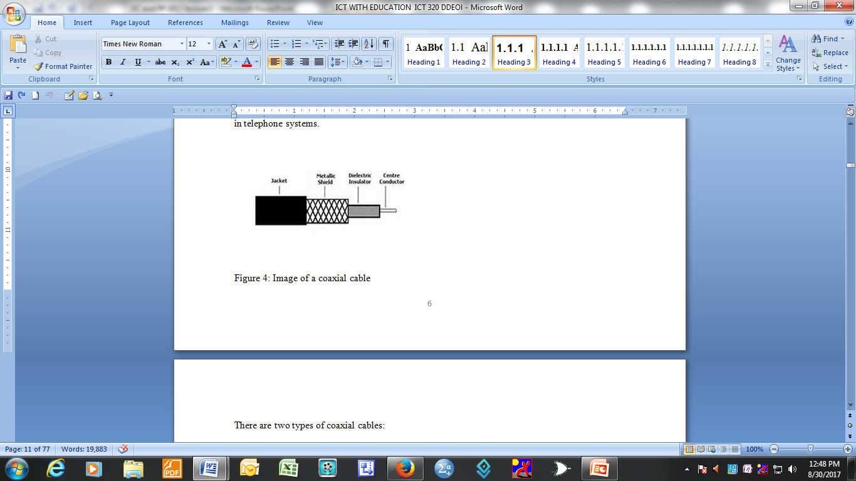

Slide 37
There are two types of coaxial cables:
Baseband coaxial cable 50 ohms
Broadband coaxial cable 75 ohms
The baseband coaxial cable is commonly used for digital data transmission and the broadband is commonly used for analog transmission.
Baseband can carry only a single signal whilst a broadband medium can be made to carry many signals at once by apportioning its total bandwidth into many independent channels, each of which carries only a specific range of frequencies.

Slide 38
